Slide 1
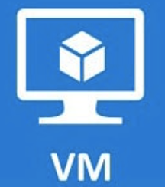
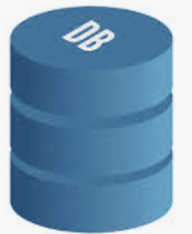








Technical Design – Medical Patient Monitoring System
Source systems – Proprietary Medical Monitoring devices
Heart Rate
Blood Pressure
ECG
Oxygen Level
Blood Sugar
Respiration rate
Body Temperature
Sleep Status
500ms
Every hour
Every second
Every 5 second
Every 2 minutes
Every second
Every 5 minutes
Every 2 minutes
MQTT protocol
Event Broker
Solace PubSub+
1 queue per source device
Real time data flow from Solace queues
Bind count = 5 per queue
Request push notification
On-premise Infra
(Primary Data Center)
Digital Certificate authentication
APN server
CaaS – Cryptography as a service encryption of PPI and CCI data
Routes Push notification
JDBC connection
Trigger download
Processing layer
MFA enabled via SAML authentication
Digital certificate authentication
OUD authorization
Password rotation via HashiCorp
Processing layer
(Rotate Patients’ vital signs every 5 sec)
Oracle Database
Load Balancer
Oracle Database
Solace
PubSub+
SSE
OAuth2 Authentication
RBAC authorization
Server-sent Events (SSE) service
Send Data event (Database extracts)
Send notification event (abnormal readings)
(Write API) -- HTTPS secure connection
https REST API
API Gateway
Read and routes Data and
notification events (Read API) real time
API service
Upload AES-256 encrypted snapshots
MyMedicalData
Logging
Application servers
Web servers
Backend Servers
Trigger download
Monitor Me
Backend integration
Enable multi threading and parallel processing for increased performance – for data consumption from solace queues
Web Based interface
MFA enabled via SAML authentication
End Users

